Slide 1

Creating a Google Survey Form
Ra
by Rachotesh Jinaga

Slide 2
Introduction
We are excited to present a project exploring the viewing habits and preferences of modern audiences. From the latest must-see TV shows to the biggest blockbuster movies, this comprehensive survey will delve into how people are consuming media in the digital age.
Platform Used :
Google Forms is a versatile tool offered by Google for creating customizable online surveys and questionnaires. With intuitive design features and seamless integration with other Google services, it allows users to effortlessly collect and analyze data. From simple feedback forms to complex research surveys, Google Forms offers a user-friendly platform for data collection.

Slide 3

Literature Survey
Identify your topic
Identify survey Objectives
Determine the focus of your survey, on media across different platforms like TV, movies, YouTube, and OTT services.
Previous surveys have investigated how viewing habits vary based on factors such as age, gender, income, and education level.
Viewing Habits Research
Existing studies have examined how people consume media across different platforms like TV, movies, YouTube, and OTT services.

Slide 4
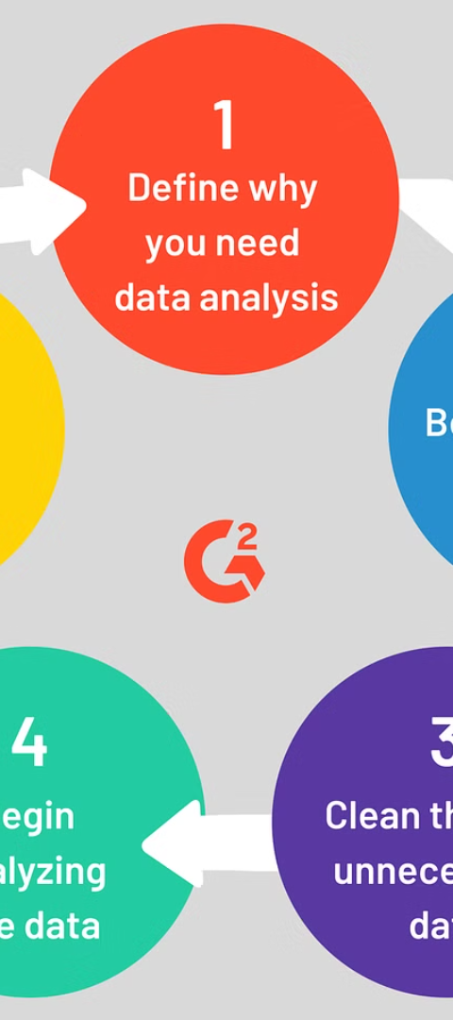
Procedures
1
Survey Design
The survey was carefully designed to capture detailed insights into TV, movie, YouTube, and OTT viewing habits, as well as reasons for not watching content.
2
Data Collection
The survey was distributed through various online channels to reach a diverse audience and collect robust data for analysis.
3
Data Analysis
The collected survey responses were rigorously analyzed using advanced statistical tools and techniques to uncover meaningful patterns and trends.

Slide 5
Data Analysis and Insights
Summarize Responses.
Segment Data.
Statistical Analysis.
Documentation and Reporting.

Slide 6

Survey Form Design :
Target Audience
Market Analysis
Choosing Appropriate Platform
Evaluating Feedbacks
Data Analysis

Slide 7
Steps to create Google Form
Access Google Forms
Start a New Form
Add Questions
Customize Form Settings
Preview and Test
Finalize and Share
Monitor Responses
Review and Analyze Results

Slide 8
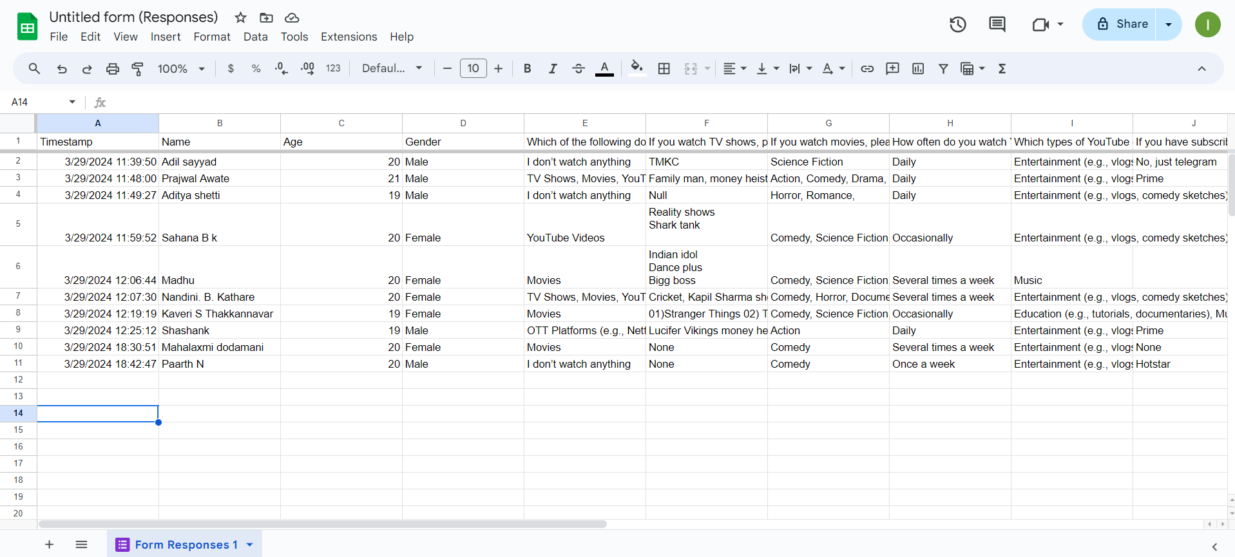
Result
Spread sheet :

Slide 9
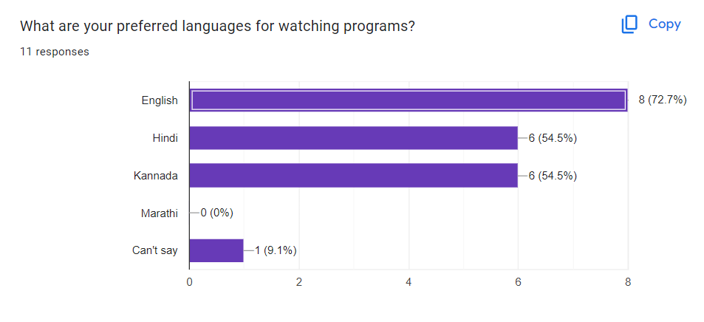
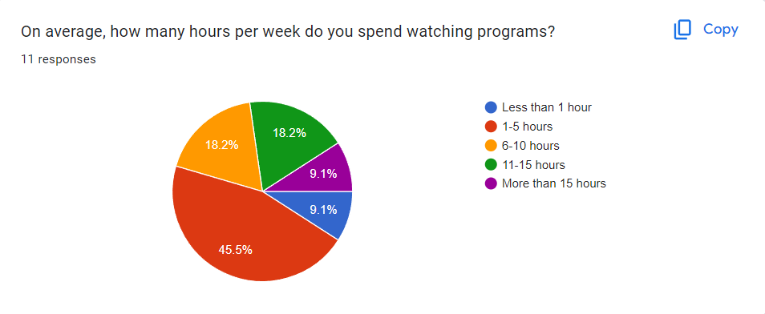
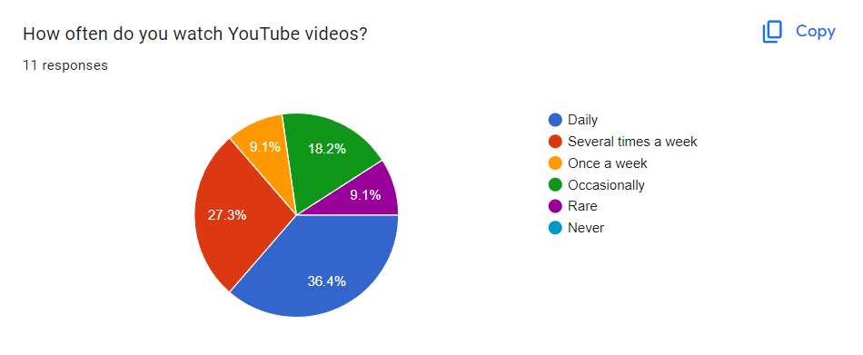
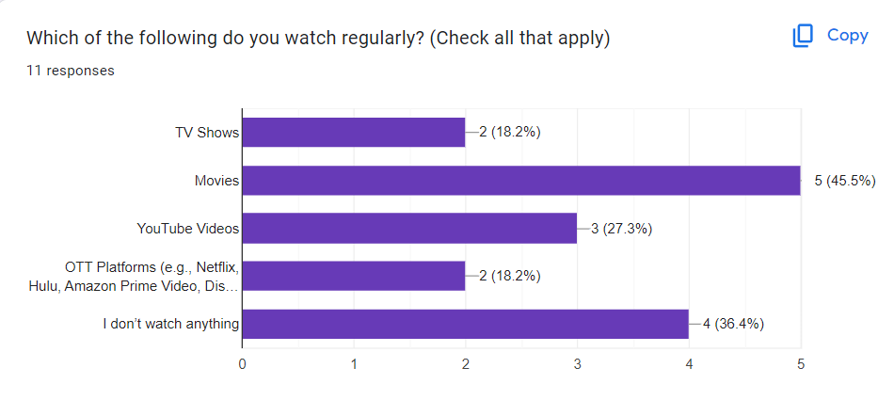

Slide 10
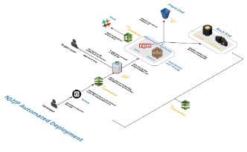
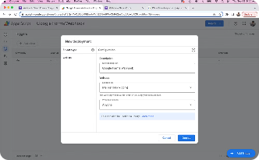
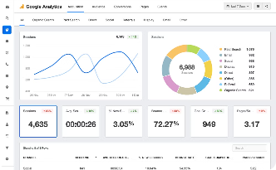

Deployment
Form Setup
Form Deployment
Analytics Tracking
Distribution
Setting up a Google Form involves creating the form, adding questions, customizing settings, and sharing it with respondents.
Integrate the Google Forms survey into the website, ensuring a smooth and user-friendly experience for respondents.
Analyze the data gathered through survey forms and prepare suitable graphs , charts etc.
Distributing Google Form effectively involves reaching target audience and encouraging them to participate in survey or complete the form.

Slide 11
Challenges and Limitations
Response Bias
Ensure the survey questions are objective and avoid leading respondents to specific answers
Sample Size
Strive to gather a sufficient number o responses to ensure the data is representative of your audience.
Data Quality
Implement measures to validate the accuracy and completeness of the survey responses.
Privacy Concerns
Respect the privacy of your participants by adhering to data protection guidelines and best practices.

Slide 12
Conclusion
In conclusion, the survey on social media usage has provided valuable insights into the preferences and behaviors of the target audience. The data collected and the analysis conducted have highlighted key trends and patterns that will inform the development of the Google survey form. Moving forward, the team will leverage these findings to design an engaging and user-friendly interface that resonates with the target audience and delivers meaningful insights to the client.
References :
https://www.google.com/forms/
Link to Google Form :
https://docs.google.com/forms/d/e/1FAIpQLSe2-
YdrzR5SCyI5BoNxhge7DQ1H90wgTLBEax
P33YbfrZVd2w/viewform?usp=sf_link

